Slide 1


The Future of Rural BC: Perspectives, Resilience, and Community Economic Development
Exploring how rural communities across British Columbia are navigating change. We'll examine challenges, opportunities, and innovative approaches to building sustainable futures.
by BC Rural Centre

Slide 2
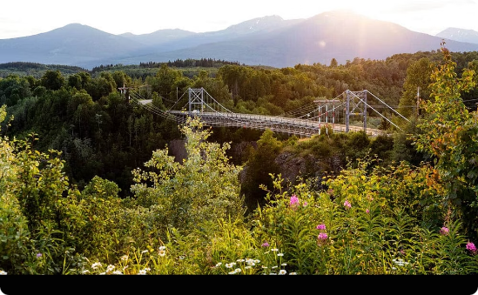

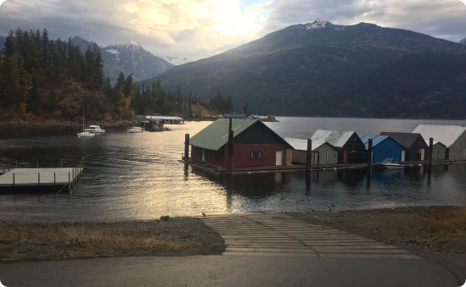
About the BC Rural Centre
BC Rural Centre
Keeping it Rural Conference
Our Offerings
A non-profit organization dedicated to strengthening rural communities across British Columbia since 2007.
Annual gathering of rural stakeholders, policymakers, and community leaders.
Tailored support for rural communities facing unique challenges.
Knowledge sharing and networking
Workshops and training programs
Research, advocacy, and capacity building
Showcasing innovative rural solutions
Consulting services and funding guidance
Community building
Connecting rural leaders with resources
Strategic Partnerships

Slide 3
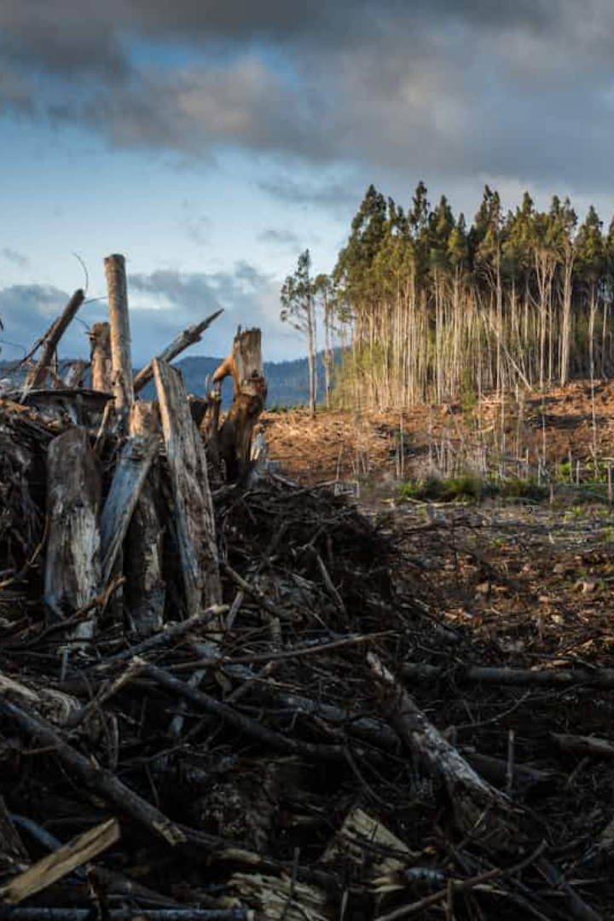
Agenda
1
Insights from the State of Rural Canada 2024 Report
We'll examine key findings relevant to British Columbia's rural regions.
2
Rural BC in Context
Understanding how provincial trends compare to national patterns.
3
Practical Solutions
Exploring community-driven approaches already making an impact.
4
Policy Recommendations
Concrete steps to support rural economic development and resilience.

Slide 4

Defining Rural BC
The Index of Remoteness has the Sunshine Coast as more remote than Haida Gwaii
Are we Beyond Hope?
Defining Rural can lead to "in the box" or "out of the box" restrictions
More than a resource hub

Slide 5
Demographic Shifts
Population Dynamics
Aging Communities
Returning Residents
Some regions face decline while others experience growth from immigration. This creates a patchwork of demographic patterns.
The median age in rural BC is rising faster than urban areas. This impacts service needs and workforce availability.
Post-pandemic, we've seen a notable increase in former residents returning to rural communities. Remote work has enabled this shift.
Notes:
Highlight demographic diversity as a factor for community planning and service provision
"You've been to one rural community to been to one rural community"
As we look at the future of rural communities in British Columbia, it is vital to acknowledge the demographic diversity that shapes these areas. Rural BC is not homogenous; instead, it consists of a mosaic of communities, each with unique characteristics, challenges, and opportunities. This diversity is not just about age or ethnicity; it encompasses varying experiences, economic needs, and aspirations

Slide 6








Economic Transition
Traditional Industries
Emerging Sectors
Forestry, fishing, and agriculture remain important. They're evolving with sustainable practices.
Renewable energy, digital technology, and eco-tourism create new economic opportunities.
Global Connections
Community Enterprises
Digital connectivity allows rural businesses to reach international markets.
Social enterprises and cooperatives are filling market gaps in rural communities.
Notes:
Rural communities in BC are leveraging local resources and innovative practices to diversify their economies and build resilience.
Tourism in Revelstoke
Manufacturing in Merritt
Agri-tourism
Mass Timber
Micro Mills
Renewable Energy Projects: Small-scale solar and wind energy initiatives are being developed to provide sustainable power solutions. SunShine Coast

Slide 7



Climate Change Impacts
Frontline Impacts
Rural and coastal communities experience climate effects first and most severely.
Increasing Risks
Extreme weather, wildfires, floods, and sea-level rise threaten infrastructure and safety.
Adaptation Strategies
Communities are developing innovative approaches to build climate resilience.
Notes:
As we address the pressing issue of climate change, it's essential to highlight the proactive climate adaptation strategies being employed in rural BC. Many communities are taking innovative approaches to mitigate the impacts of climate change while enhancing their resilience.
community-wide climate action plans
In the Okanagan Valley, local governments and farmers are adapting to changing weather patterns by utilizing soil moisture monitoring technology. This helps optimize irrigation practices, conserve water, and ensure sustainable agricultural production despite extreme drought conditions.
In Northern BC, communities like Fort St. John are integrating climate resilience into infrastructure planning.

Slide 8

Infrastructure and Service Gaps
Aging Infrastructure
Healthcare Access
Roads, water systems, and public buildings require significant investment. Many communities lack resources for maintenance.
Only 59% of rural BC residents live within 10km of primary care. Provider shortages create serious challenges.
Digital Connectivity
Nearly 40% of rural BC households lack access to high-speed internet. This limits economic and educational opportunities.
Notes:
• Our communities are facing significant infrastructure challenges, with aging roads, water systems, and public buildings that require major investment.
• Many local governments simply don't have the resources to properly maintain this critical infrastructure, leading to growing gaps in service.
• Access to healthcare is another major concern, especially in rural areas. Only 59% of rural British Columbians live within 10 kilometers of primary care, creating serious barriers to getting the medical attention they need.
• Lack of high-speed internet connectivity is also a major problem, with nearly 40% of rural BC households lacking access. This digital divide limits economic and educational opportunities for these communities.
• Addressing these core infrastructure and service gaps will be essential to supporting the long-term wellbeing and prosperity of all British Columbians, no matter where they live.

Slide 9





Indigenous Reconciliation
Meaningful Partnerships
Effective development requires true collaboration with Indigenous communities.
Indigenous Knowledge
Traditional practices offer sustainable approaches to resource management.
Shared Leadership
Joint governance models create more equitable and effective outcomes.
Economic Cooperation
Shared ventures create prosperity for Indigenous and non-Indigenous communities alike.
Notes:
• Effective reconciliation requires meaningful partnerships with Indigenous communities, built on mutual understanding and respect.
• Indigenous knowledge and traditional practices offer valuable, sustainable approaches to resource management that can benefit everyone.
• Shared leadership through joint governance models creates more equitable and effective outcomes for all.
• Economic cooperation through shared ventures can generate prosperity for both Indigenous and non-Indigenous communities.
• These four key elements - partnerships, knowledge, leadership, and cooperation - are critical to advancing true reconciliation and creating a more just, inclusive future.

Slide 10





Community-Led Innovation
Food Security
Affordable Housing
Transportation
Local food systems are growing through community gardens and regional distribution networks.
Community land trusts and cooperative housing models address the housing crisis.
Volunteer rideshare programs and community buses fill transit gaps.
Social Enterprises
Business models that balance profit with community benefit create sustainable solutions.
Notes:
Community-led innovation is about local communities coming together to address challenges and create solutions that benefit the whole community.
This slide highlights 4 key areas where community-led innovation is making a difference: food security, affordable housing, transportation, and social enterprises.
In food security, we're seeing the growth of community gardens and regional food distribution networks that keep food production and access local.
On affordable housing, community land trusts and cooperative housing models are empowering communities to develop and manage their own affordable housing.
For transportation, volunteer rideshare programs and community buses are filling gaps in public transit, connecting people to jobs, services, and each other.
And social enterprises are creating business models that balance profit with community benefit, generating sustainable solutions.
The common thread is communities taking the lead to solve problems in ways that work for them, rather than top-down, one-size-fits-all approaches.

Slide 11






Governance and Capacity
Innovative Governance
New models of shared services and regional cooperation
Human Resources
Attracting and retaining qualified staff
Fiscal Capacity
Limited tax base and funding challenges
Small municipalities face significant capacity constraints. Many have fewer than five staff members handling complex responsibilities from infrastructure to economic development.
Notes:
• Municipalities, especially smaller ones, often face significant capacity constraints in areas like governance, human resources, and fiscal capacity.
• Innovative governance models, such as shared services and regional cooperation, can help address these challenges.
• Attracting and retaining qualified staff is a key issue, as many small municipalities have very limited staff capacity.
• Fiscal constraints are common, with a limited tax base and funding challenges making it difficult to invest in infrastructure and economic development.
• These capacity constraints require creative solutions to ensure municipalities can effectively serve their communities.

Slide 12

Challenges and Opportunities
Challenges
Opportunities
Skilled labour shortages
Skilled talent attraction
Housing affordability crisis
Innovative housing models
Climate adaptation costs
Green economy leadership
Infrastructure maintenance
Federal/provincial investment
Notes:
• The challenges we face include skilled labour shortages, a housing affordability crisis, climate adaptation costs, and infrastructure maintenance.
• On the other hand, there are significant opportunities, such as attracting skilled work talent, developing innovative housing models, leading the green economy, and securing federal and provincial investment.
• These challenges and opportunities will be key focus areas as we chart the path forward for our communities.
• It's important that we address these issues head-on and leverage the opportunities to create a more prosperous and sustainable future.

Slide 13

Policy Recommendations
Foster Rural Innovation Ecosystems
Support Indigenous-Led Development
Invest in Rural Infrastructure
Create support systems for entrepreneurs and community enterprises in rural settings.
Develop a National Rural Strategy
Provide resources for Indigenous communities to lead economic initiatives on their territories.
Prioritize broadband, transportation, and healthcare facilities. Address the maintenance deficit in existing infrastructure.
Create a comprehensive framework that recognizes the unique needs of rural communities. This must include rural BC perspectives.
Notes:
• A provincial rural strategy is critical to address the unique needs of rural communities across BC
• We must ensure this strategy includes perspectives from rural communities themselves
• Investing in rural infrastructure like broadband, transportation, and healthcare facilities is essential
• Addressing the maintenance deficit in existing infrastructure is also a key priority
• Supporting Indigenous-led economic development on their territories is crucial
• We need to create support systems to foster innovation and entrepreneurship in rural settings

Slide 14
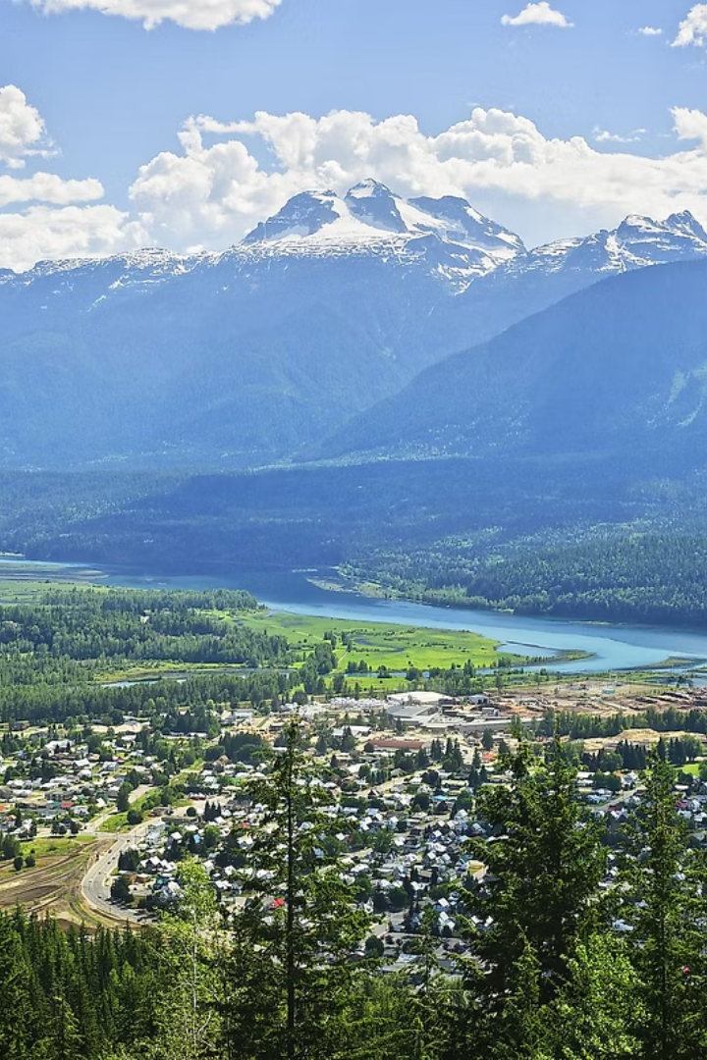
Future Outlook
60%
95%
Renewable Energy
Connectivity
Potential increase in rural BC's renewable energy capacity by 2030
Target for high-speed internet access in all rural communities
25%
Housing
Projected growth in non-market housing options in rural BC
Rural BC communities are positioned for sustainable growth through targeted investments and policy support.
Notes:
• The future outlook for rural BC communities is promising, with significant potential for growth in key areas.
• Renewable energy capacity in rural BC could increase by 60% by 2030, providing a valuable clean energy source for these communities.
• Connectivity is also a priority, with a target of 95% high-speed internet access in all rural communities to support economic and social development.
• While housing remains a challenge, with 25% projected growth in non-market housing options, there is a focus on expanding affordable and accessible housing options.
• Overall, strategic investments and policy support are positioning rural BC communities for sustainable growth in the years ahead.

Slide 15

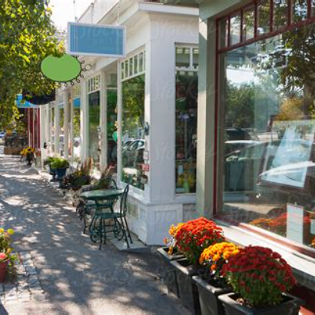
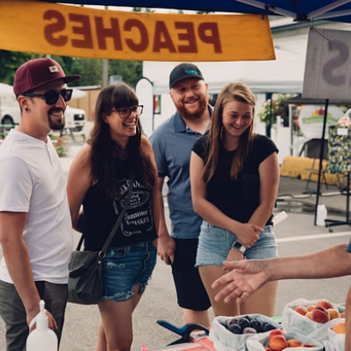
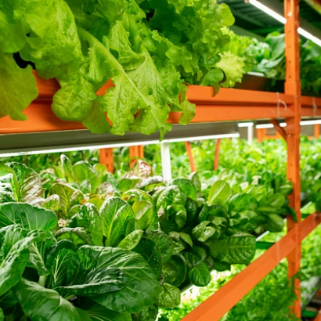
Your Role in Rural BC's Future
Your decisions shape rural communities' futures. Together, we can build resilient, vibrant rural regions through policy, partnership, and innovative thinking.
Notes:
Rural BC's future is shaped by the decisions we make today
As leaders and community members, we have a responsibility to build resilient, vibrant rural regions
This can be achieved through thoughtful policy, strategic partnerships, and innovative approaches
The images on this slide represent some of the key elements of rural life - community, natural beauty, technology, and local industries
Our goal is to harness these strengths to create a thriving, sustainable future for rural British Columbia

Slide 16





Connect With BC Rural Centre
Your rural development partner, supporting rural, remote, and First Nation communities across British Columbia.
Website
www.bcruralcentre.org
Email
sarah@bcruralcentre.org
Phone
1.833.RURL.911
Contact Us
We love hearing from you!
Scan the QR code to join our newsletter list. Let's build rural resilience together.
Notes:
The BC Rural Centre is your rural development partner, supporting rural, remote, and First Nation communities across British Columbia.
Our website at www.bcruralcentre.org has information about our services and initiatives.
You can reach us by email at sarah@bcruralcentre.org or by phone at 1.833.RURL.911.
We love hearing from you, so please don't hesitate to contact us if you have any questions or would like to learn more.
Finally, be sure to scan the QR code to join our newsletter list so we can stay connected and build rural resilience together.

Slide 17

Keeping it Rural Conference 2025
Agriculture • Forestry • Innovation • Community Development • Healthcare • Economic Development • Alternate Energy • Sustainable Tourism
June 10-12, 2025 • Kelowna • Four Points by Sheraton YLW
Learn More and Register at:
https://bcruralcentre.org/keeping-rural-conference/
Notes:
• Welcome to the Keeping it Rural Conference 2025!
• This annual event brings together professionals from a variety of rural sectors - agriculture, forestry, innovation, community development, healthcare, economic development, alternate energy, and sustainable tourism.
• The conference will take place June 10-12, 2025 in Kelowna, at the Four Points by Sheraton YLW.
• I encourage you all to visit the conference website at bcruralcentre.org/keeping-rural-conference to learn more and register.
• This conference is a fantastic opportunity to network, share ideas, and explore solutions for the unique challenges and opportunities facing rural communities.

