Slide 1
Asset Management - Governance and Operations
October 31, 2024
Greg Sawatzky

Slide 2
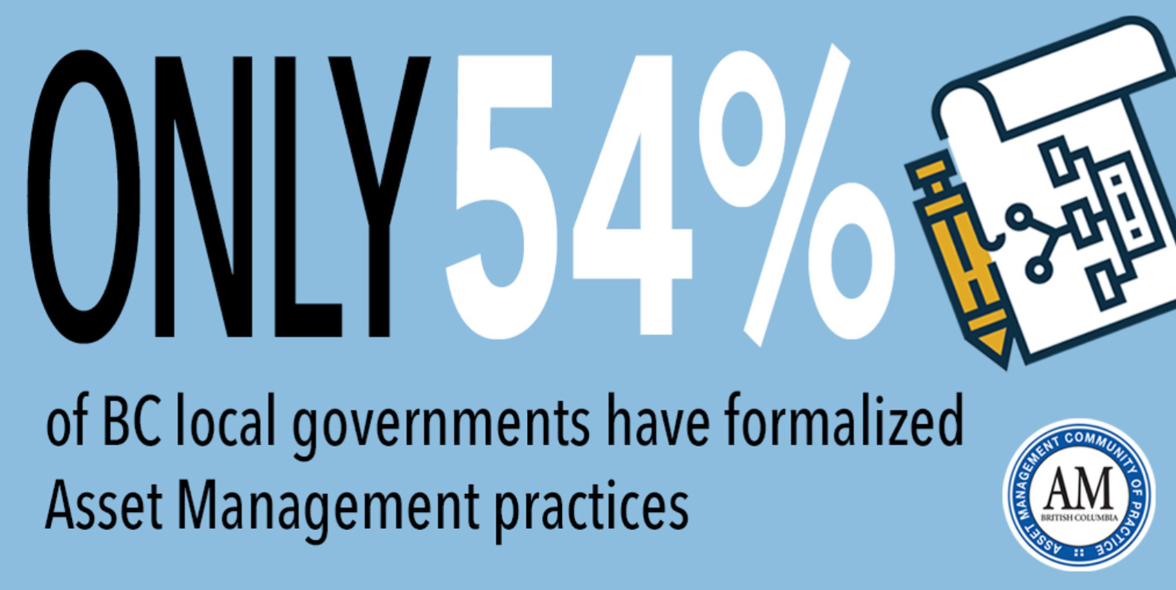
Today’s Highlights
What is Asset Management?
The Asset Management System
Asset Management Governance Documents - Policy and Strategy
Asset Management Plans

Slide 3
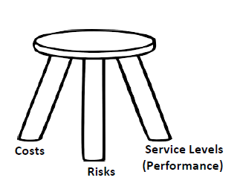
Asset Management is a process that supports good governance, accountability, and transparency in local government.

Slide 4
What are Assets?
Assets are physical components of a system that enables a service, or services to be provided.
Engineered assets are the designed and constructed components of infrastructure systems. For example, roads and water treatment plants are engineered assets.
Natural assets are ecosystems or natural resources that communities rely on for critical services community functioning and overall well-being.

Slide 5
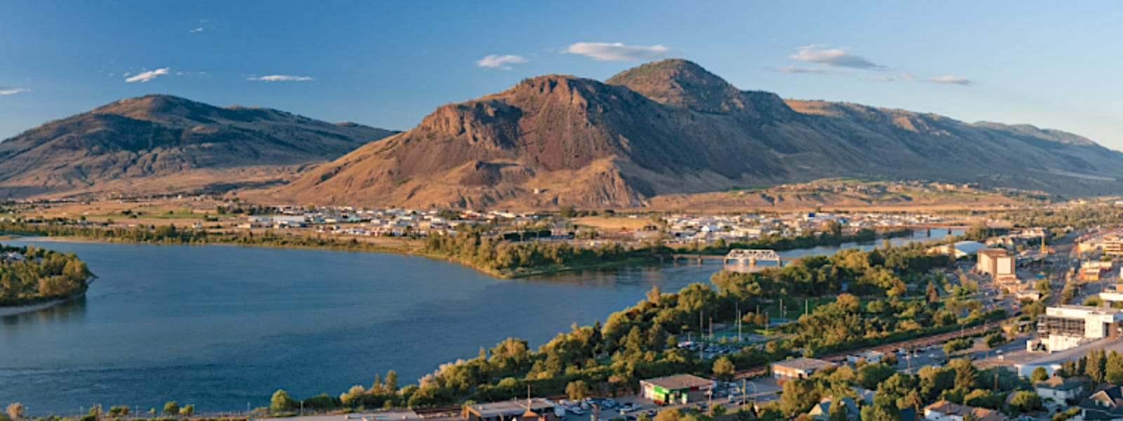
Natural Assets
Examples
Benefits
rivers and creeks
foreshore areas
wetlands
forests
aquifers
flood protection
drainage and rainwater attenuation
water treatment and storage,
recreation
air quality

Slide 6
What is Asset Management?
IBM: Enterprise Asset Management (EAM) is the combination of software, systems and services that maintain and control operational assets and equipment. The aim of EAM is to optimize the quality and utilization of assets throughout their lifecycle, increase productive uptime and reduce operational costs.
CNAM: Asset Management is the coordinated activities of an organization to realize value from its assets in the achievement of its organizational objectives.
AMBC: Asset Management is the process of integrating people’s skills and actions with information about the community’s physical infrastructure assets and financial resources to ensure long term sustainable service delivery. Sound asset management practices support sustainable service delivery.

Slide 7
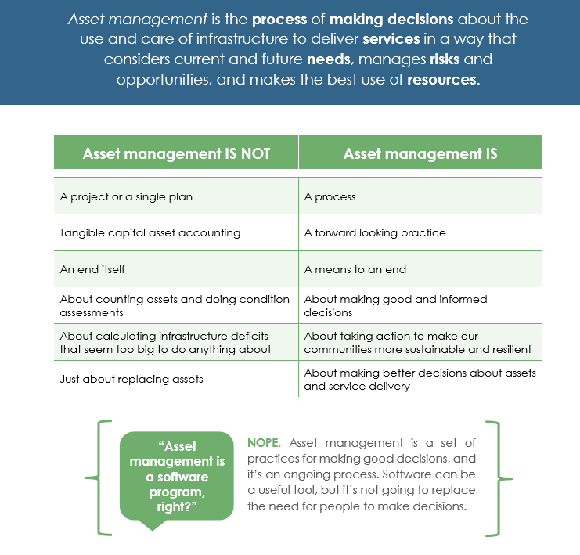

Slide 8
ISO Standards Governing AM: Guide for Policy, AM Strategy, Legislation like O. Reg. 588/17
ISO 55000: Asset Management – Vocabulary, Overview, and Principles
ISO 55001: Asset Management – Asset Management System Requirements
ISO 55002: Asset Management – Management Systems – Guidelines for the Application of ISO 55001
ISO 55010: Asset Management – Guidance on the Alignment of Financial and Non-Financial Functions
ISO 55011: Asset Management – Guidance for Public Policy Development
ISO 55012: Asset Management – Guidance on People Involvement and Competence
ISO 55013: Asset Management – Guidance on Data Management

Slide 9
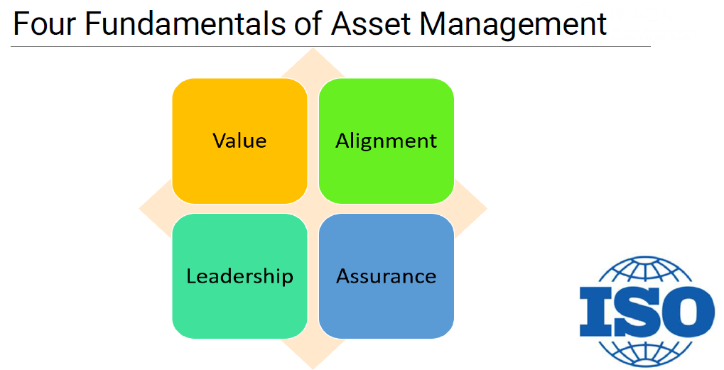

Slide 10
Value: Don’t lose sight of the purpose of assets in delivering a service with value.
Alignment: Ensure Asset Management planning links performance to strategic objectives.
Leadership: Have a process to inform senior executive/board of requirements and progress. They control resources and can’t demonstrate leadership in AM without appropriate information.
Assurance: Implement a system of regular review to assess progress against targets and ensure there is a reporting process to decision makers.

Slide 11
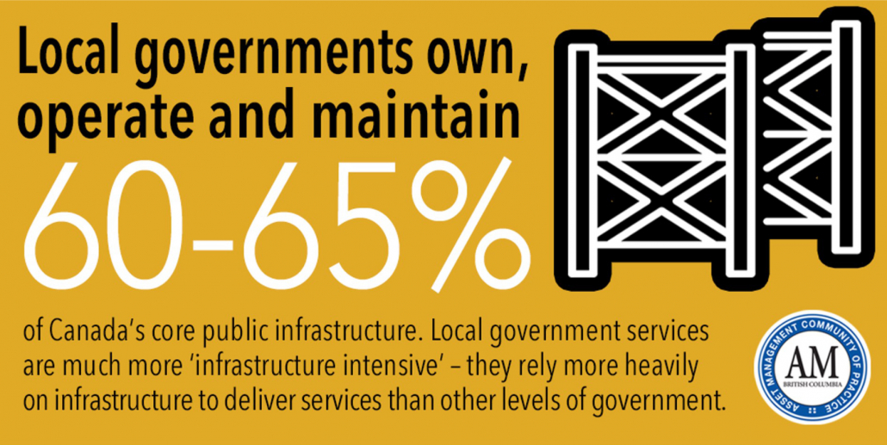
What are (Some of) the Benefits of Asset Management?
Adequate quality information to support decision-making.
Effective and reliable delivery of critical services, today and into the future.
Reduced lifecycle costs of service delivery.
Enhanced value of a community’s investment in assets over their lifecycle.

Slide 12
Continued …
Defensible prioritization of limited resources using a consistent and repeatable system
Improved financial planning and better management of deferred maintenance and any unfunded
liability associated with renewing or replacing aging engineered assets
Alignment of organizational and community objectives with technical and financial decisions and actions
Demonstrated stewardship that builds confidence with constituents, customers, and other stakeholders

Slide 13
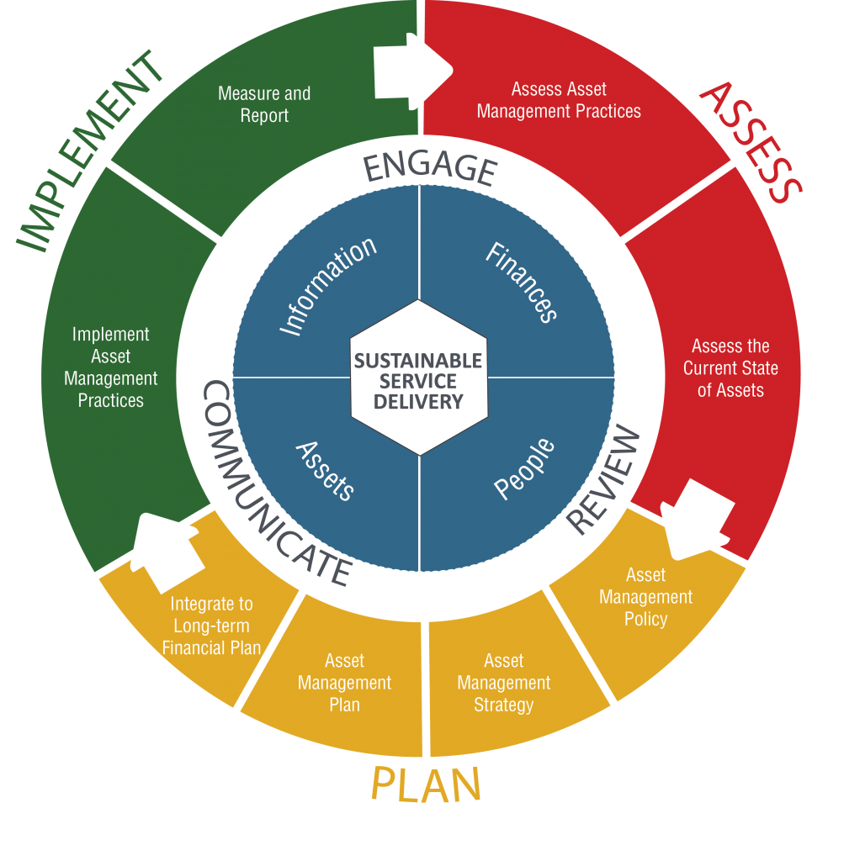
The Asset Management System

Slide 14
What is an AM system?
The ISO Asset Management Standards (ISO 55000 Series) defines the asset management system as the: Set of interrelated or interacting elements of an organization to establish policies and objectives, and processes to achieve those objectives.

Slide 15

Asset Management Governance Documents

Slide 16
An Asset Management Policy Will:
Organization Level: Set out the principles that guide how AM will be implemented to achieve the AM objectives.
Elected Officials Level: State how the top of the organization the elected officials will provide a commitment to AM.
Senior Management Level: State how top management will provide a commitment to AM.
Integration Level: Be consistent with the organizations strategic plans, objectives and policies.
  The Organizational Strategic Plan/Official Community Plan (OCP)
  Asset Management Strategy (SAMP)
  Asset Management Plans (AMPs)
  Long Term Financial Plan (LTFP)

Slide 17
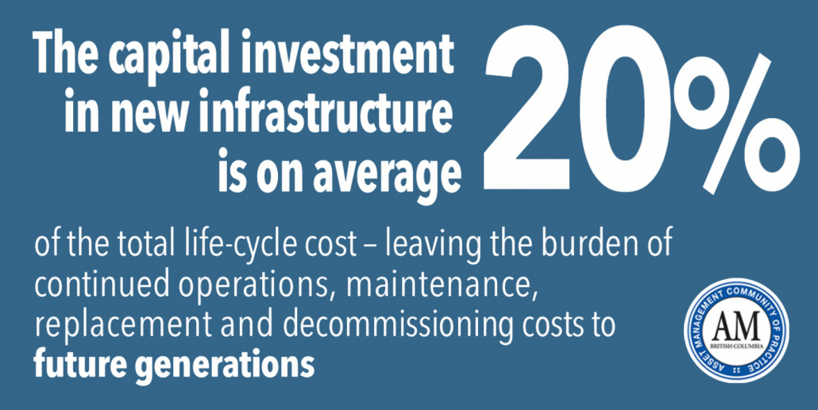
What is an Asset Management Strategy/Strategic AM Plan?
A Strategic AM Plan (or AM Strategy) gives effect to the AM Policy
It establishes the AM Objectives
It sets out how the organization will achieve its AM objectives
Provides direction for activities such as AM Plans and program of works

Slide 18
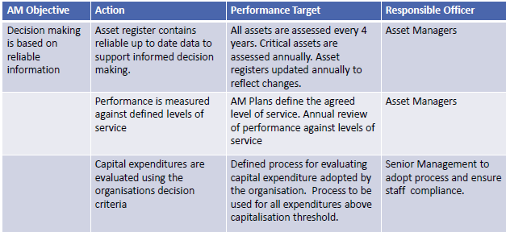

Slide 19

ACT II

Slide 20
The Asset Management Plan
Plan
Assess
Implement

Slide 21
Asset Management Plans – Defined by AMBC
“Long-term plans that outline the assets, asset conditions, levels of service, asset and service risks, activities and programs for each service area and resources required to provide a defined level of service in the most cost-effective way. Each Asset Management Plan is a readable and user-friendly living document that is continuously improved to incorporate new information or changing requirements.”
Natural Assets
Climate change considerations
Accessibility and equity regulations

Slide 22

AM Plans are the “Business Case” for your Assets!
To ensure the financial sustainability of infrastructure services
To support funding applications
To provide input into a Long-Term Financial Plan
To document existing and planned work practices and procedures
To support community engagement on levels of service and cost
To meet regulatory requirements (Ontario)

Slide 23
Asset Data Required for Asset Management:
What Assets do we own?
What services are provided by these assets?
Where are the assets located?
What are their attributes?
What is their depreciated value and replacement value?
What is their condition?
What is their expected remaining life?

Slide 24
Questions addressed by AM Plans based on the data collected
What is the current and desired level of service?
What service and asset risks need to be prioritized and managed?
When will interventions need to occur to manage risk and meet level of service targets?
What O&M activities will optimize the lifecycle of the asset?
What will it cost?
Which assets can be disposed?
What new assets may be required and when?

Slide 25
AM Plan Structure and Contents
The Executive Summary: Context
Introduction: History/background
Levels of Service: Current levels of service
Future Demand: Demand management plans
Lifecycle Management Plan: Background perspective
Risk Management Plan: Risk Assessment
Financial Summary: Financial statements and projections
Plan Improvement and Monitoring: Status of Asset management practices
References; Supporting corporate planning documents
Appendices

Slide 26
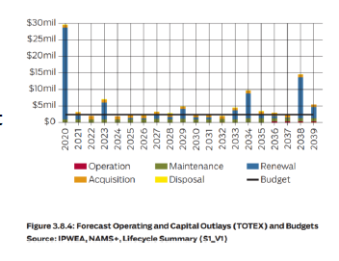
Long Term Financial Plan for AM Plan Output

Slide 27
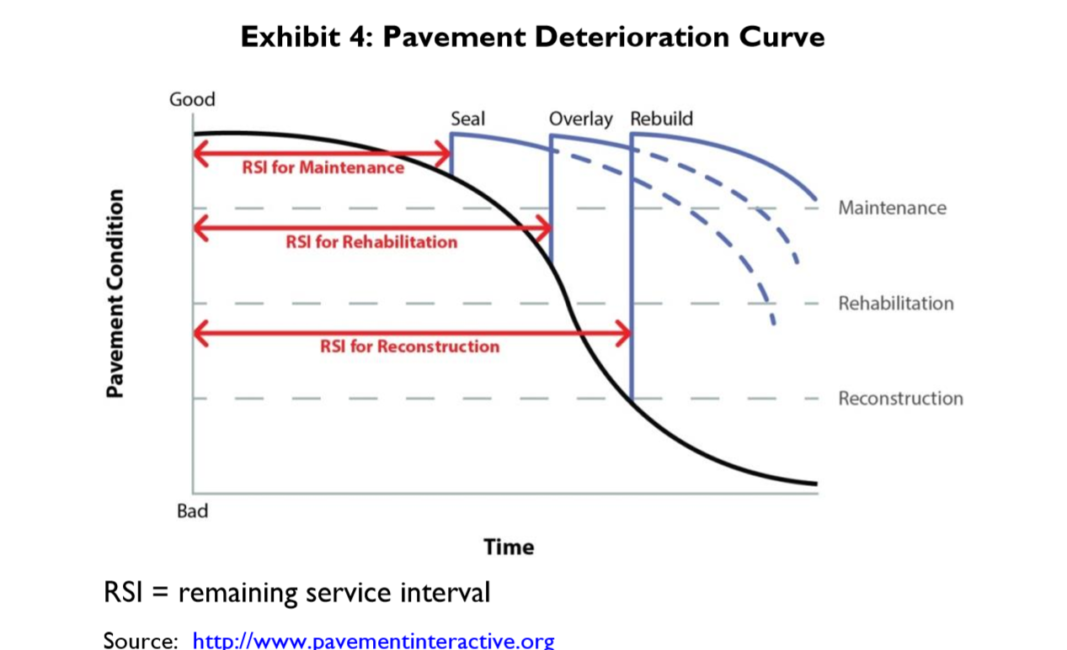
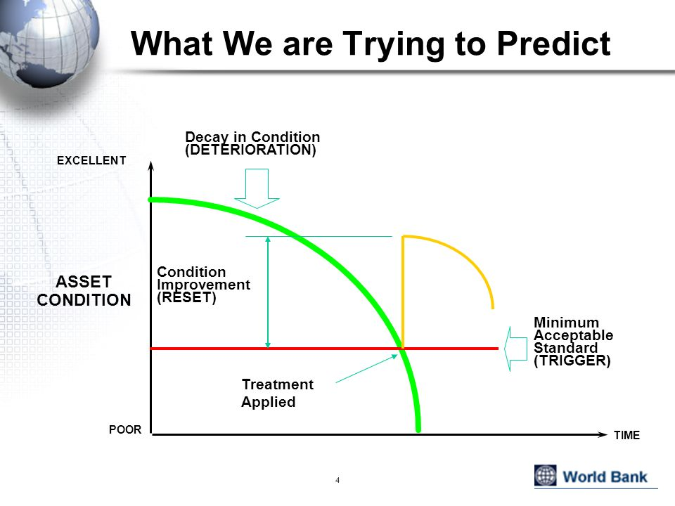
AM Nessy Curve

Slide 28
The Enablers:
People: Adequate staffing levels, competency requirements
B. Data and Information: Consistent and verifiable
C. Systems and Tools: Software, uniformity in data governance
D. Processes: Documented and appropriate to the organization
E. Outsourcing: Does not absolve the asset “owner” from responsibility

Slide 29
Technical tools:
Enterprise Asset Management System (EAMS): Provides link from operational and capital activities to budgets.
Financial system: Accounts payable, accounts receivable, payroll, budgeting.
Long term financial planning tool: Combines technical and financial date, project decision support, funding gap analysis.
Asset repository: Records of assets and their attributes (financial information, age, condition)
Supplementary Data collection tools: Data collection configured to automate and augment the processes of other systems.

Slide 30
The Importance of Perspective:
Combining financial and technical perspectives creates new perspectives on assets and the services they provide
Different perspectives promote more options for capital and maintenance interventions
Considering options leads to more sustainable service delivery and better ability to manage expectations

Slide 31
Self Study Resources:
Asset Management BC (AMBC): assetmanagementbc.ca
Federation of Canadian Municipalities (FCM): fcm.ca
Canadian Network of Asset Managers (CNAM): cnam.ca
PEMAC AM Association of Canada: pemac.org
Municipal Natural Assets Initiative (MNAI): naturalassetsinitiative.ca
NAMS Canada namscanada.org
Institute of Public Works Engineering Australasia (IPWEA): ipwea.org
Me: LinkedIn, gsawatzky@kamloops.ca

Slide 32
Thank You!

